Slide 2
Patient and Nurse Journey
Lucy Hatchard from West Hertfordshire NHS Trust

Slide 3
Troy Deeny has fallen over playing at Vicarage road stadium and thinks he has broke his leg!!
Who should we call for help?
A- Taxi
B- His Mum
C – Bat Man
D- Ambulance

Slide 4
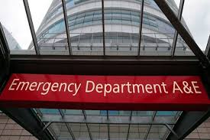
Troy is in the ambulance….great stuff. Where is the ambulance going to take him?
A – A+E
D- Pharmcy
B - GP
C- Nandos

Slide 5
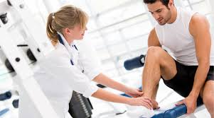
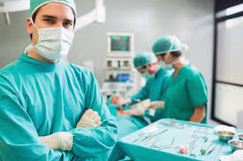
Troy has arrived safely at A+E.
Who will the first person Troy will see when he gets to the hospital?
A - Doctor
B - Physiotherapist
C - Surgeon
D-Nurse

Slide 6
Poor Troy is in quite a lot of pain, who can give him some pain killers?
A- Pharmacy
B- Nurse
C- Doctor
D- One of the receptionists

Slide 7
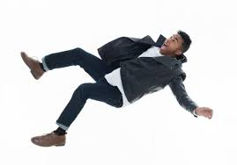
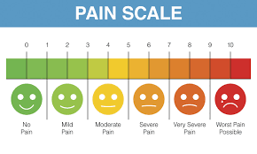
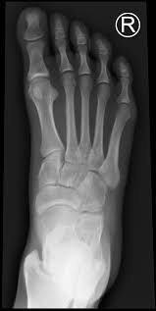
Troy is feeling much more comfortable after his pain killers. How are we going to diagnose the extent of his injury?
A- Poke his leg until he screams?
D - Ask him to stand up and see if he falls over, if he does we will know it is broken.
C- Ask him how much it hurts?
B – X-Ray

Slide 8
Tory has definably broken his leg! He needs to go to surgery.
Who will Troy see first when he goes into the operating Theatre?
A- Nurse
C -Surgeon
D - Receptionist
B –Team mate Ben Foster

Slide 9
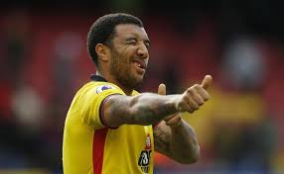
The surgeons have been able to fix Troy’s leg….whoohooo he will play again!
Who will wake Troy up after his operation?
A- Alarm clock
B- Doctor
C- Nurse
D- His Manager

Slide 10
Troy is back on the ward now, although his leg has been fixed he’s in loads of pain! Who will help Troy?
A- His Tik Toc Followers
B- Pain Specialist Nurse
C- Pharmacist
D- Physio therapist

Slide 11
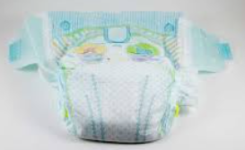
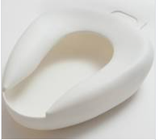
Troy is feeling much better but he still cant walk and he needs the loo! How will Troy go to the toilet ??
A- Put a Nappy on
C- Crawl on his hands and knees to the toilet
B- Use a bed pan

Slide 12
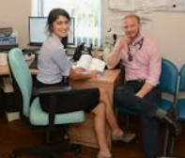
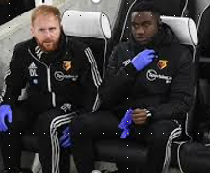
Troy is ready to go home at last! He’s got a dressing on his leg. Who will change this when he is home?
A – GP
C- District Nurse
B – The club doctor

